Slide 1
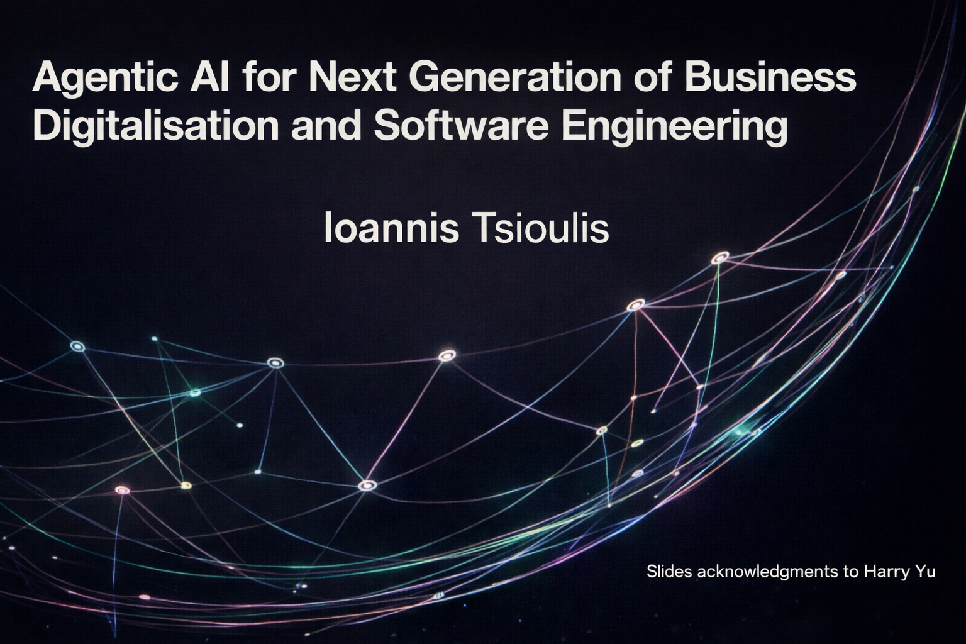

Slide 2
Agenda
Agentic AI
AI opportunities and challenges for business
A case study in finance
AI for software engineering
Challenges and future research

Slide 3
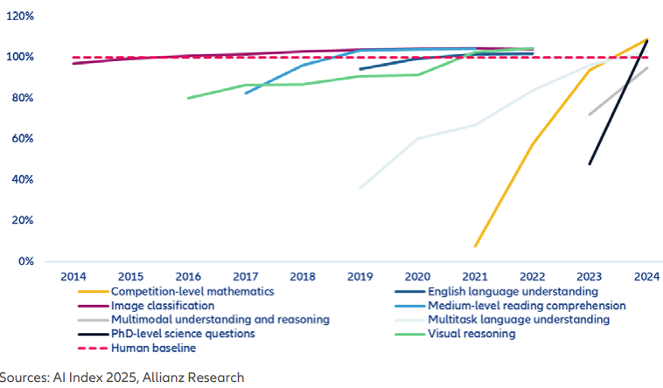
The AI Revolution

Slide 4

Agentic AI
What are the major differences between humans and other animals?
Using tools efficiently, including combining several tools
Logical reasoning using long-term memory and cause-effect feedback
Multi-step thinking
Agentic AI refers to AI systems that can autonomously plan, reason, and take actions to achieve goals by using tools, interacting with external systems, and adapting through memory and feedback. Unlike traditional AI or standalone LLMs, agentic AI operates as a coordinated set of intelligent agents capable of multi-step decision-making, workflow execution, and domain-aware problem solving.

Slide 5
Comparison: Traditional AI vs LLMs vs Agentic AI
Feature | Traditional AI Systems (Non-LLM) | LLMs | Agentic AI Systems
Core Capability | Task-specific models (e.g., classification, prediction) | Natural language understanding and generation | Autonomous multi-step reasoning, planning, and execution
Flexibility / Generalisation | Limited — performs only the task it was trained for | High — general-purpose and adaptable to many domains | Very high — dynamically adapts tasks, tools, and workflows
Autonomy | None — requires scripted logic or human-defined rules | Very low — responds only to user prompts | High — can plan, act, and iterate without direct human input
Learning Approach | Supervised/unsupervised ML; requires structured data | Self-supervised on massive text datasets | Hybrid learning via LLM + tools + memory + domain rules
Memory & Adaptation | No internal memory beyond model parameters | Minimal short-term context; no persistent memory | Long-term memory (KG, embeddings, logs, rules) enabling continuous improvement
Reasoning Ability | Narrow reasoning (rule-based or statistical) | Strong language-based reasoning but not always accurate | Structured, verifiable reasoning using planning, tools, and logic
Tool / API Integration | Manual integration via programming | Can request tool calls (function calling) but needs an external application to run them | Native tool use (API calls, databases, search, file systems)
Real-World Actions | Only through pre-programmed pipelines | Not capable of independent action | Executes tasks autonomously across systems and platforms
Scalability Across Domains | Low — each domain needs its own model | Moderate to high — same LLM can be reused | High — agents specialise and collaborate across domains
Explainability | Often transparent (decision trees, classical ML) or opaque (deep learning) | Reasoning mostly implicit, often difficult to explain | Can provide explanations using structured reasoning and memory
Human Interaction | Limited to UI/UX designed for one task | Strong conversational interaction | Conversational + operational workflows + multi-agent orchestration
Typical Use Cases | Fraud detection, image classification, forecasting, optimisation | Chatbots, writing assistance, coding, Q&A | Workflow automation, enterprise AI assistants, multi-tool orchestration, data integration, decision support

Slide 6
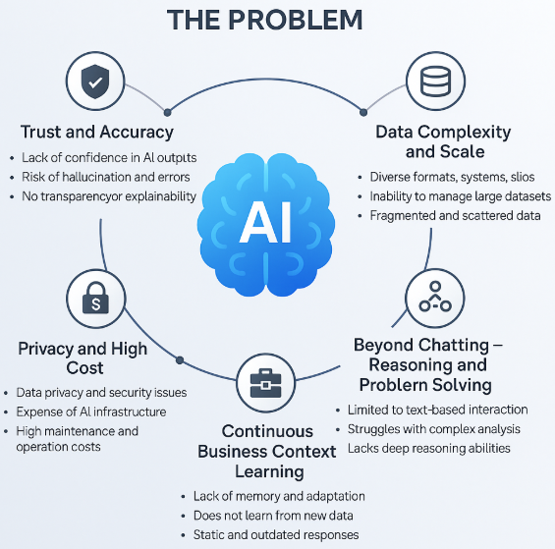
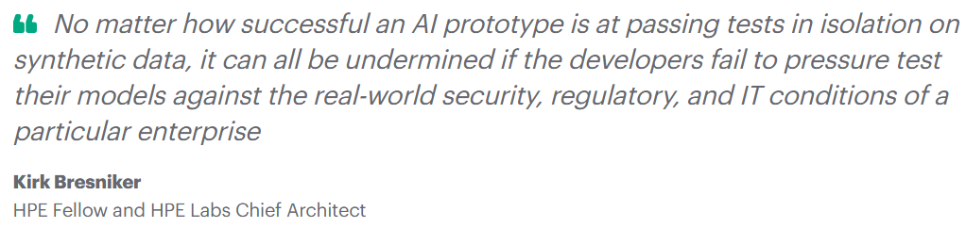
Businesses aren’t yet confident to adopt AI, but it is a huge market
What we need is an enterprise AI framework/product/service that empowers businesses/organisations to build their own intelligent ecosystem — free from the common challenges of trust, scalability, reasoning, organisation context learning, and privacy governance.

Slide 7
Agentic AI - Trustworthy
Agentic AI systems offer higher trustworthiness because they combine multiple safeguards that traditional AI models and standalone LLMs lack. They use structured reasoning, domain rules, and long-term memory to verify outputs, cross-check information, and correct errors. By integrating external tools, databases, and knowledge graphs, Agentic AI reduces hallucinations and produces evidence-based answers rather than relying solely on statistical text prediction. Their ability to validate results, maintain transparency in decision steps, and operate within defined workflows makes them significantly more reliable and auditable. This multi-layered approach to reasoning, verification, and accountability enables Agentic AI to deliver consistent, accurate, and context-aware outcomes—making it more trustworthy for real-world and safety-critical applications.

Slide 8
Agentic AI for Economics in General
As a data scientist (Connecting and Preparing the data, Data Analysis, Data Visualisation, Prediction Model Generation and Reasoning)
As a literature-study tutor to support researchers focusing on more complex analytical work, thereby increasing productivity.
Capable of autonomous decision-making and executing complex tasks without human intervention – marks a significant leap in artificial intelligence, with the potential to profoundly reshape economies and labor markets across the globe. [Agentic AI: The self-driving economy? www.allianz.com]

Slide 9
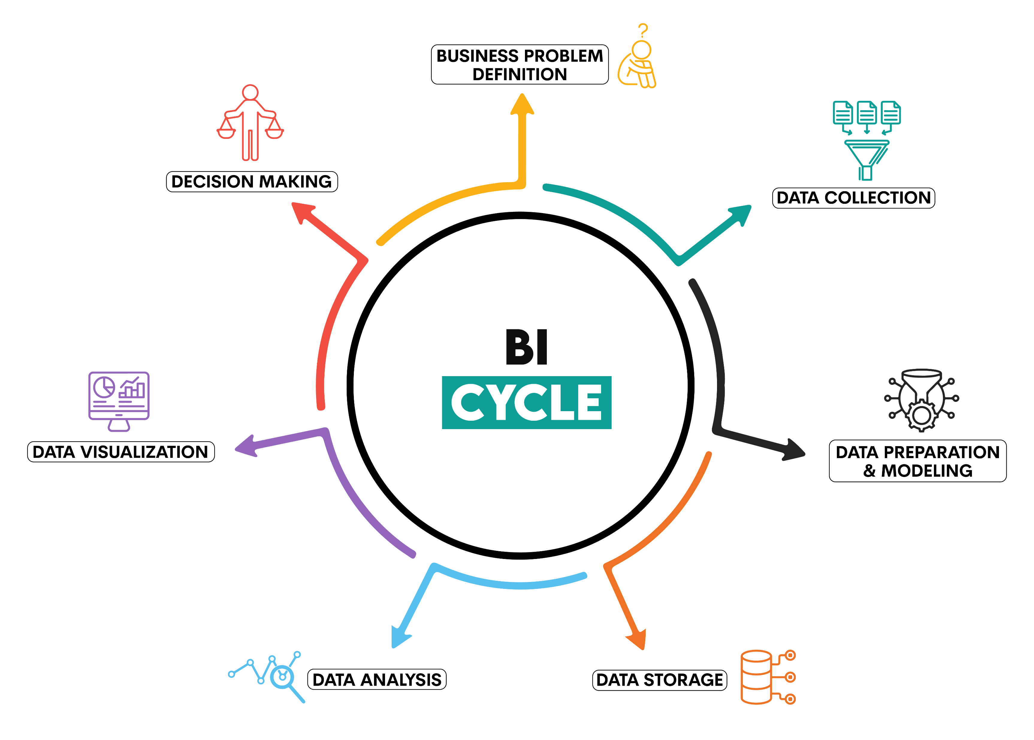
New functions to support automated business execution – from a business intelligence point of view
Automated transformation of raw data into structured databases
Creating relationships between datasets dynamically
Integrating human logic with automated business logic learning process
Directly provide decision recommendations rather than human-based data analysis results
Providing evidence of reasoning steps for the decision-making

Slide 10

Finance Case Study
Interpath Advisory: Home – Interpath
Different bank loan data reports as Excel or CSV with very different financial terms and different report structure.
It is very hard for them to check the data in the report to support decision making
Now we provide them with an Agentic AI solution
We have now completed the first stage of case studies and demo; the second stage is planned to start in February 2026

Slide 11
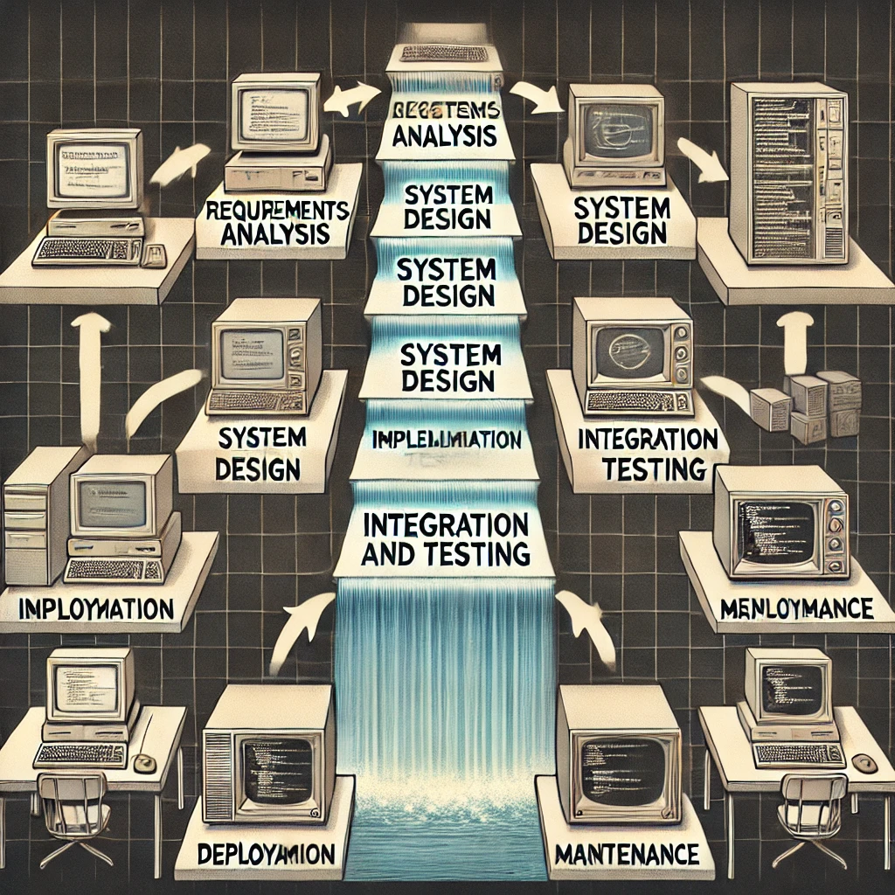
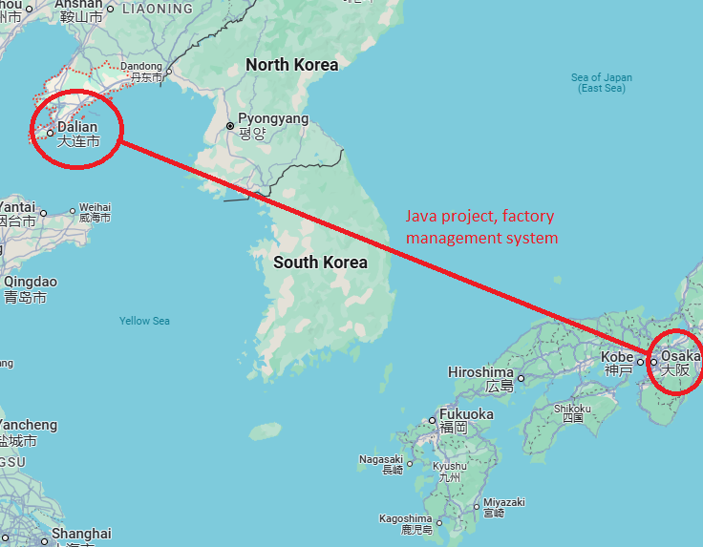
Software Engineering (Stone Age: Waterfall)
Developing software for others
Characteristics:
Sequential Process: Each stage must be completed before moving on to the next.
Documentation Heavy: Extensive documentation at each stage.
Rigid Structure: Limited flexibility to accommodate changes once the project has progressed past the initial stages.
Long Development Cycles: Projects often had lengthy development times due to the sequential nature of the process.
2001

Slide 12

Software Engineering (Bronze Age: Agile)
Developing software inside the organisation
Key Principles of Agile:
Customer Collaboration: Continuous interaction with customers to gather feedback and refine requirements.
Iterative Development: Breaking down the project into small, manageable iterations or sprints, typically lasting 1-4 weeks.
Flexibility: Ability to adapt to changing requirements and feedback, even late in the development process.
Continuous Improvement: Regular reflection and adaptation of processes to enhance efficiency and product quality.
Cross-Functional Teams: Encouraging collaboration among team members with different expertise to achieve common goals.

Slide 13

Software Product/SaaS Engineering (Iron Age)
Developing products for organisations
User- and business-centric
Data-driven
Cloud and microservices architecture
Own the product and are responsible for its successes and failures in supporting business decision-making, whereas software engineering owns only the code and whether the system runs successfully

Slide 14
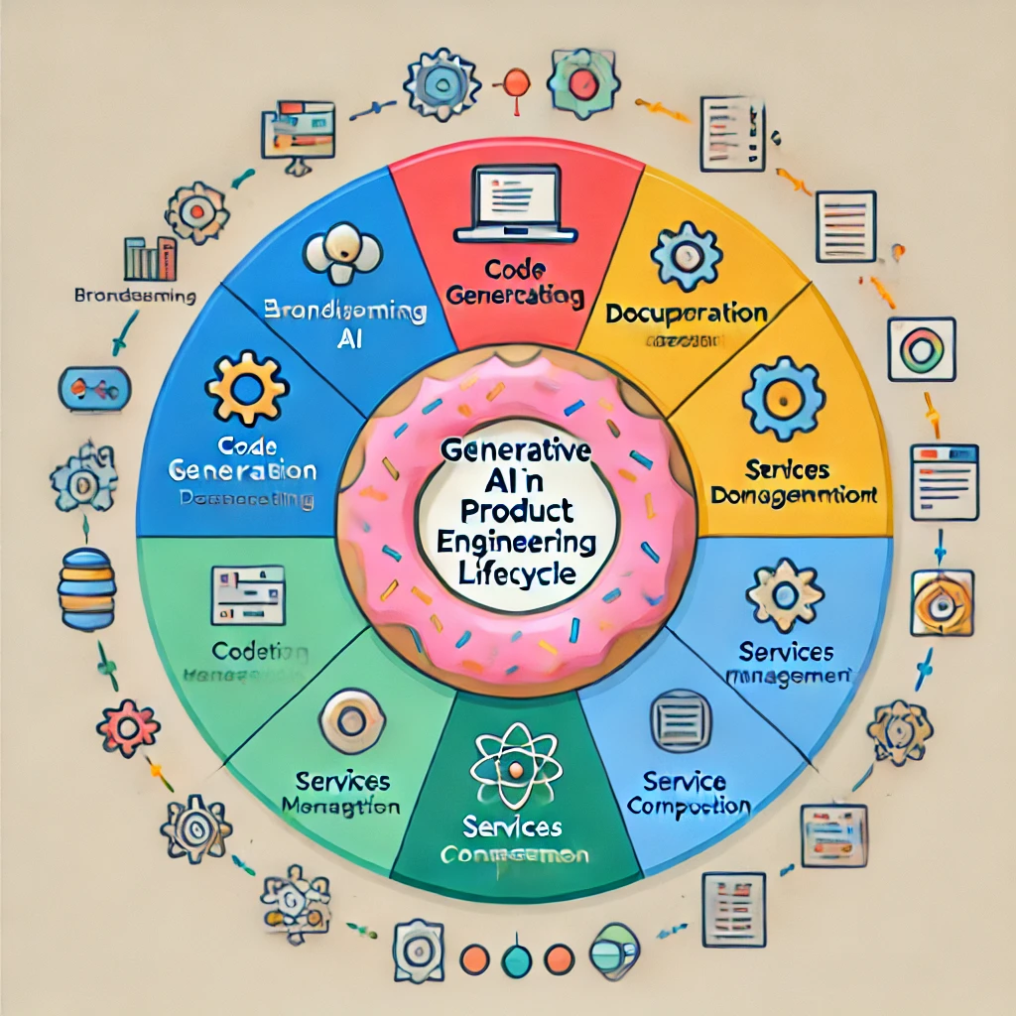
Generative AI (The AI Revolution)
Generative AI refers to a class of AI models, particularly Large Language Models (LLMs), that can generate text, code, and other creative content.
Generative AI as an assistant for the whole development lifecycle of product engineering. Brainstorming, code generation, UI design, testing, and documentation.
In addition, Generative AI can be enhanced to work as an Agent to handle complex tasks such as microservices management and orchestration. Therefore, you can have a new function at run-time without human development.
Integrating the software product for the organisation by using its own service architecture and data services

Slide 15
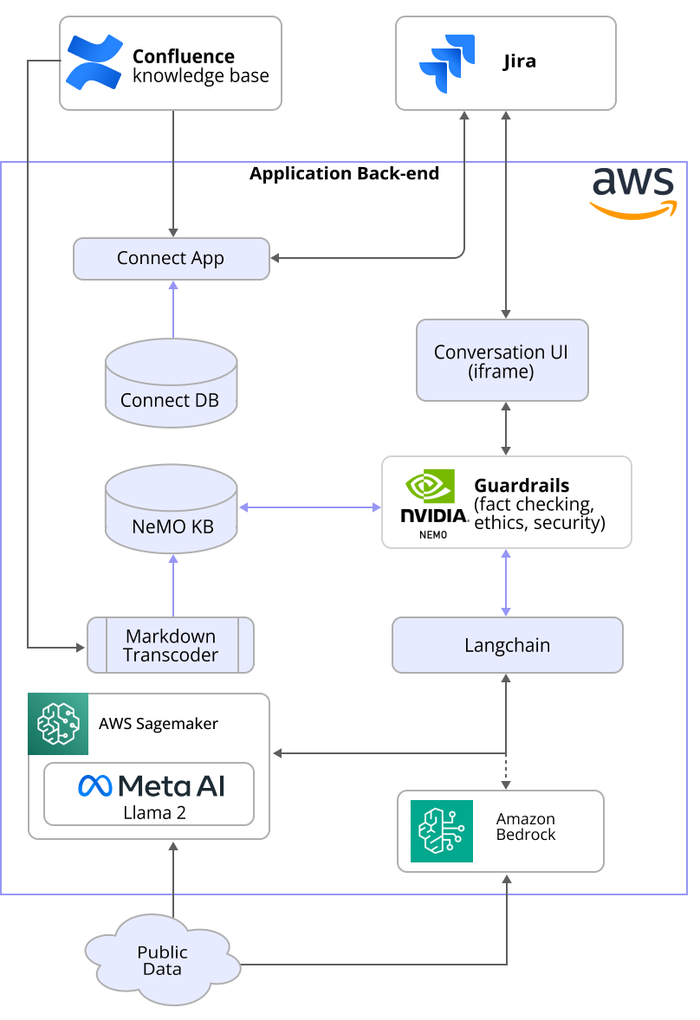
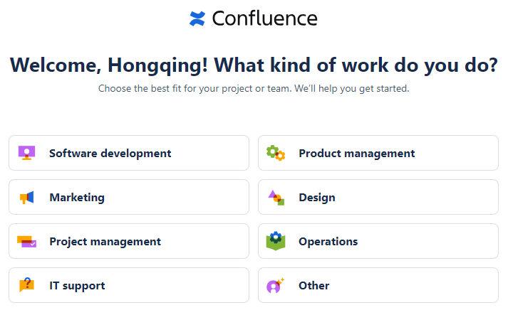
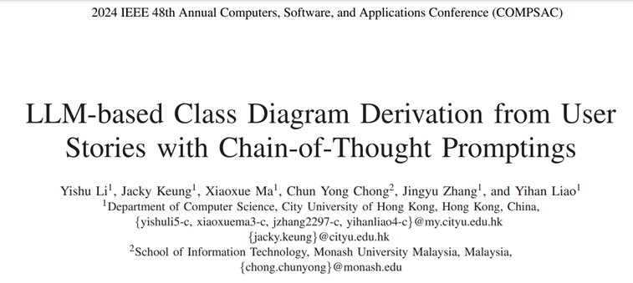
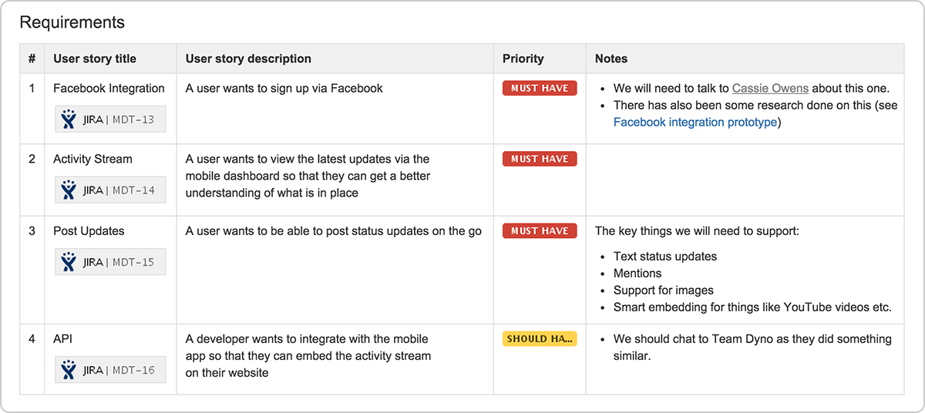
Generative AI used in software product engineering – Functional Specifications
PhD project (working with Siemens): Combining AI Language Models and Digital-Twins For Systems Design in Rail Transport
Notes:
Summarisation, audit log of conversations, safety, ethics and bias checks

Slide 16
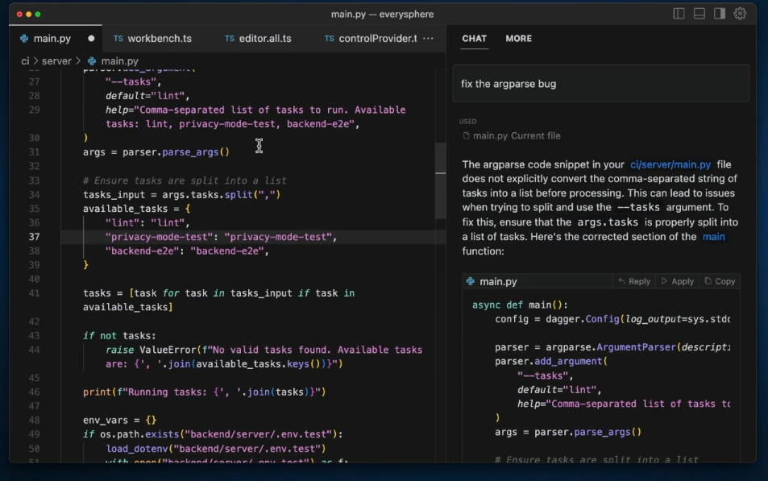
Generative AI used in software product engineering – Code Generation
Generative AI models can automatically produce code snippets or even complete applications based on high-level specifications. This capability enables developers to focus on more complex tasks, while the AI handles routine coding, saving significant time and effort. AI tools can predict the next part of a code sequence, suggest completions, and detect potential errors in real time. This not only accelerates the coding process but also enhances code quality by identifying issues early on.
https://www.cursor.com/

Slide 17
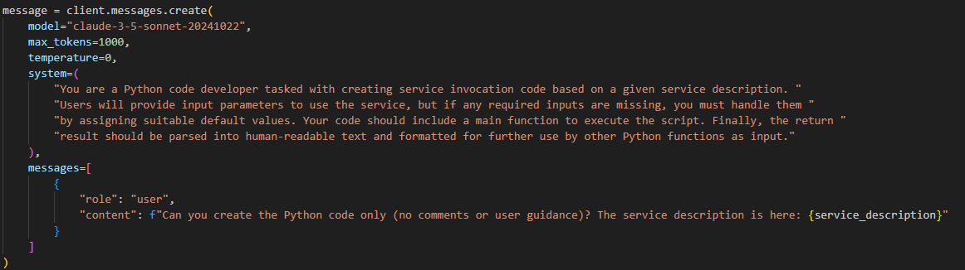
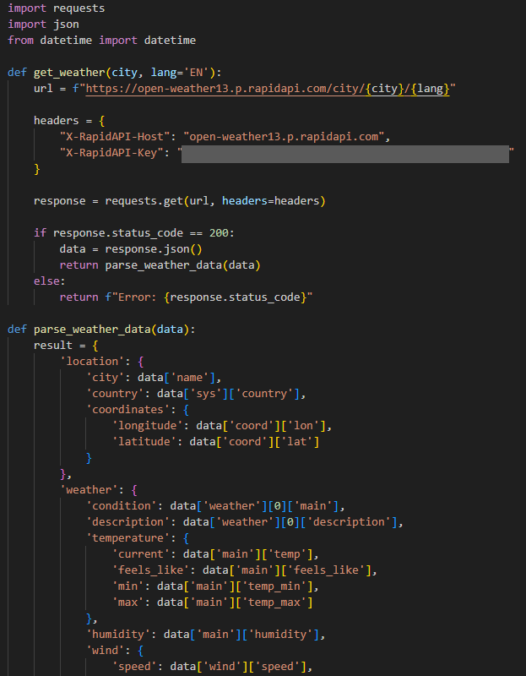

Slide 18
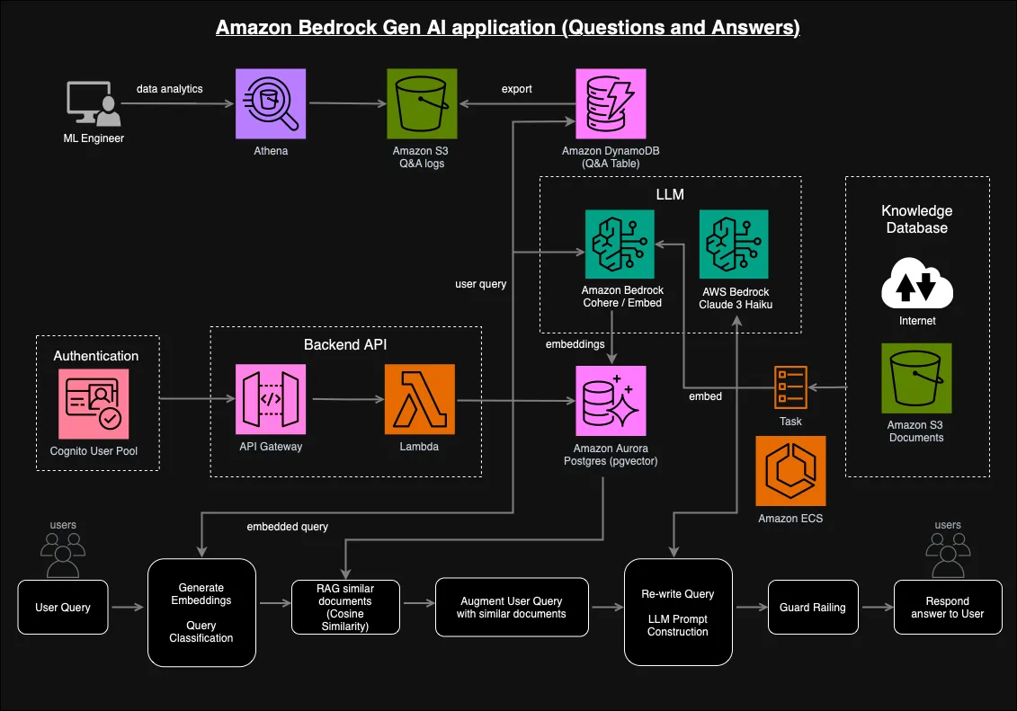
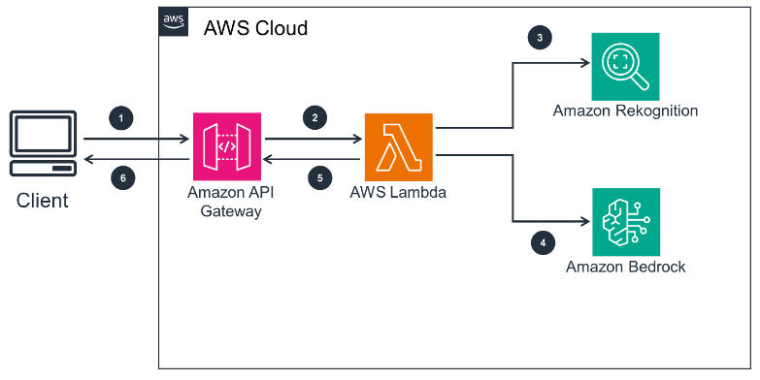
Generative AI used in software product engineering – Enterprise Cloud AI product
Step 1: The client sends a request including input data (either a product image or a basic product description to enhance) to the Amazon API Gateway REST API.
Step 2: API Gateway passes the request to the Lambda function through a proxy integration.
Step 3: When operating on product image inputs, Lambda calls the machine learning service (Amazon Rekognition) to detect objects in the image. Descriptions of the objects detected can then be fed into subsequent steps to create a product description.
https://docs.aws.amazon.com/solutions/generating-product-descriptions-with-amazon-bedrock/
Step 4: Lambda calls large language models (LLMs) hosted by Amazon Bedrock to produce product descriptions. The LLMs can either enhance existing basic text descriptions or generate new descriptions based on the objects detected by Amazon Rekognition.
Enterprise RAG system

Slide 19
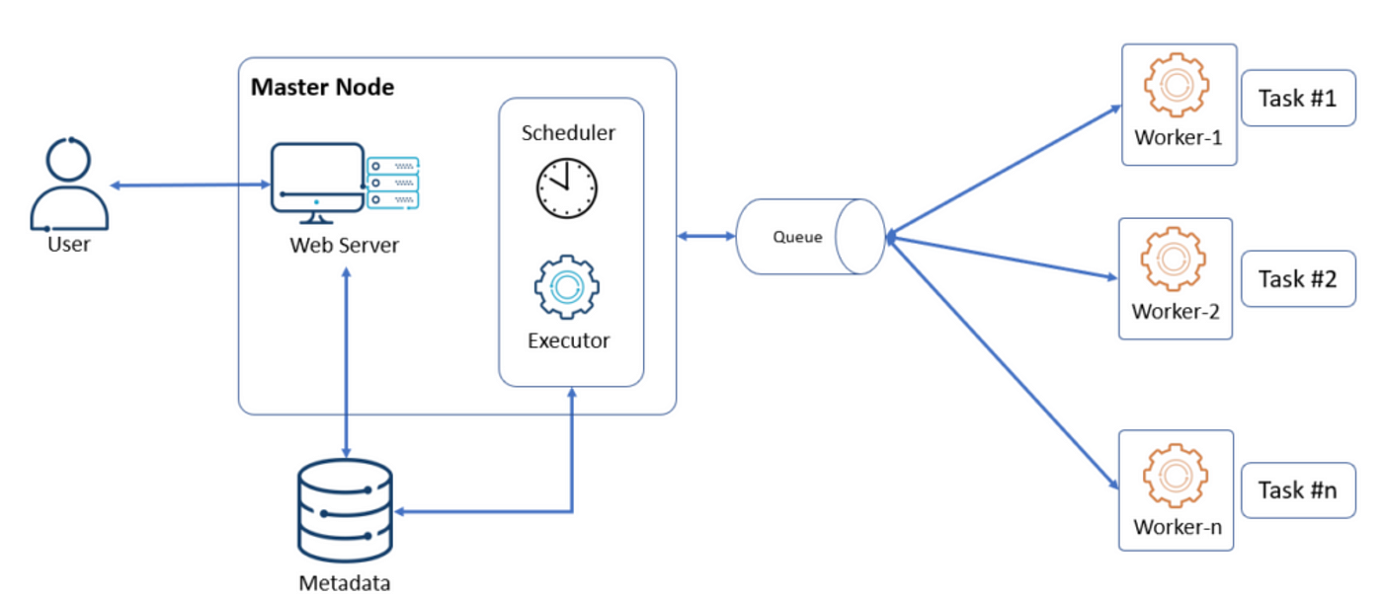
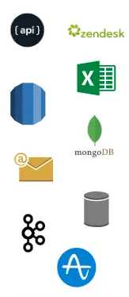
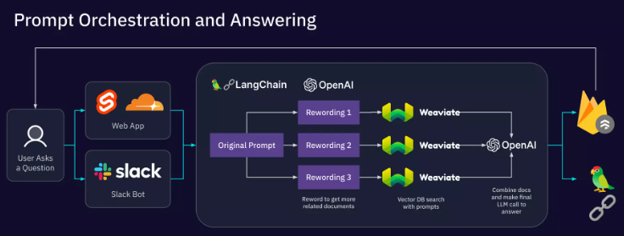
Generative AI used in software product engineering – Enterprise Data Source orchestration to create new products
Integration of Multiple Data Sources
  Generative AI can aggregate and harmonize data from various enterprise systems, databases, and APIs.
  Examples: Integrating CRM data, operational data, and market data to generate new insights and create predictive analytics models.
Airflow Architecture: data pipeline orchestration
Creating New Data Products
  Orchestrating enterprise data with Generative AI to create entirely new datasets or products, such as personalized customer insights, trend predictions, and automated reports.
  Example Use Cases: Real-time business intelligence dashboards, tailored data services, and AI-driven customer behavior analytics.
Benefits for Product Engineering
  Enhanced Data Utilization: Generative AI transforms raw data into meaningful insights, enabling the creation of new data products.
  Faster Innovation: By combining diverse data sources, enterprises can quickly generate new data-driven products and services.
  Improved Decision-Making: AI-driven orchestration helps create data products that provide actionable insights for better business outcomes.

Slide 20
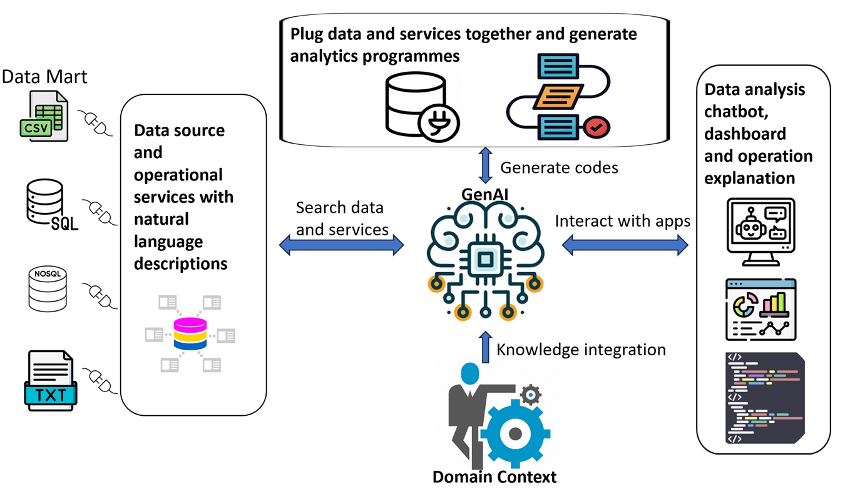
LLM-centric microservices and data dynamic orchestration framework for Data Analytics

Slide 21
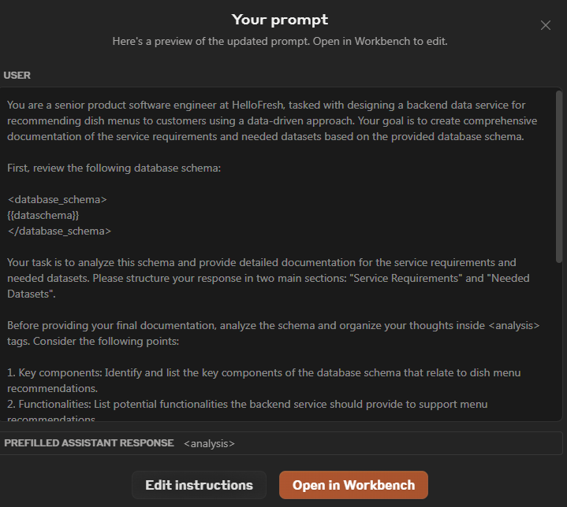
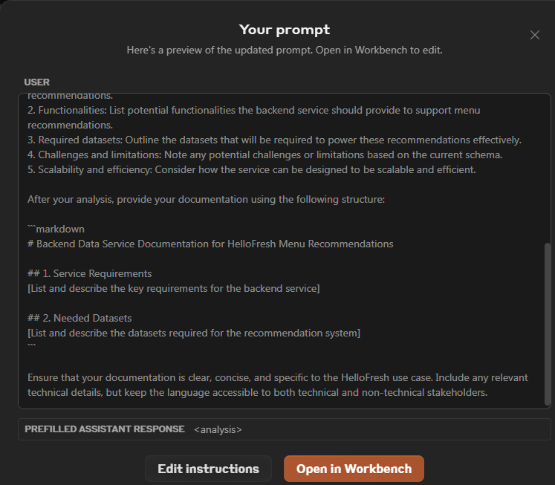
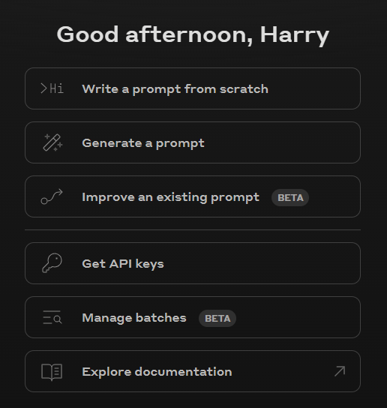
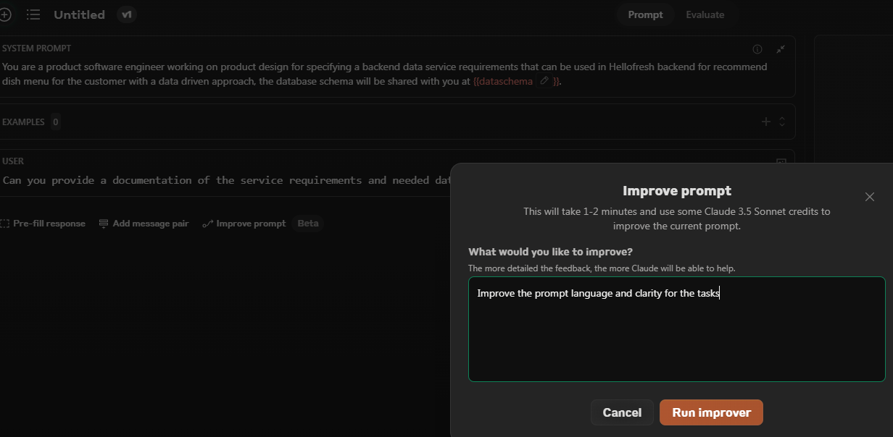
Generative AI used in software product engineering – Prompt Engineering
Prompt engineering
Notes:
https://platform.claude.com/

Slide 22
Challenges
Integration of LLM tool kits
Quality Control, Reliability and Trust
Security and Ethical Concerns
Scalability and Integration
Resource Consumption

Slide 23
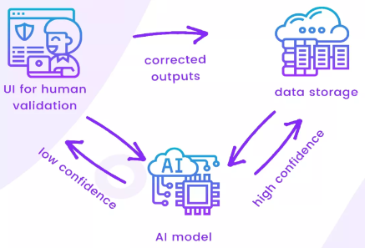
Quality Control, Reliability and Trust
Quality Control Challenges:
Unpredictable output, Difficult debugging, Testing Complexity.
Reliability Issues:
Inconsistency across versions, Lack of determinism, Model drift.
Building Trust in AI-Generated Contents:
Human-in-the-Loop approach, Explainability and transparency, Rigorous testing and validation, User training and awareness
https://www.linkedin.com/pulse/power-human-loop-finance-artificial-intelligence-theoremlabs-io-ep3gc/
Notes:
The adoption of generative AI in software production presents significant quality control challenges. Generative models like Large Language Models (LLMs) generate outputs that are not always consistent in quality, which can result in unpredictable or erroneous code. The complexity of AI-generated code often surpasses that of manually crafted code, leading to the following issues:
Unpredictable Outputs: Generative AI models may produce code that is syntactically correct but logically flawed. The resulting errors can be subtle and difficult to detect during traditional code reviews, leading to potential bugs that are hard to isolate.
Difficult Debugging: Debugging AI-generated code can be particularly challenging because the logic behind the generated segments is not always clear to developers. Unlike human-written code, which is often accompanied by a rationale, AI-generated code might lack the context needed for easy troubleshooting.
Testing Complexity: Ensuring that AI-generated code is properly tested requires comprehensive test coverage. Automated testing strategies must be adapted to account for the unique characteristics of generative AI outputs, with a focus on edge cases and unexpected scenarios.
Inconsistency Across Versions: Generative AI might produce inconsistent results across multiple iterations or versions of a project, making it difficult to maintain software stability over time.
Lack of Determinism: Unlike traditional programming approaches, where the behavior of code is predictable, generative AI can introduce non-deterministic behavior. This unpredictability makes it challenging to replicate issues, which complicates debugging and maintenance.
Model Drift: Over time, generative models may experience 'model drift' where their performance changes due to updates or changes in the training data. This drift can result in the generation of unreliable code that diverges from established software quality standards.

Slide 24
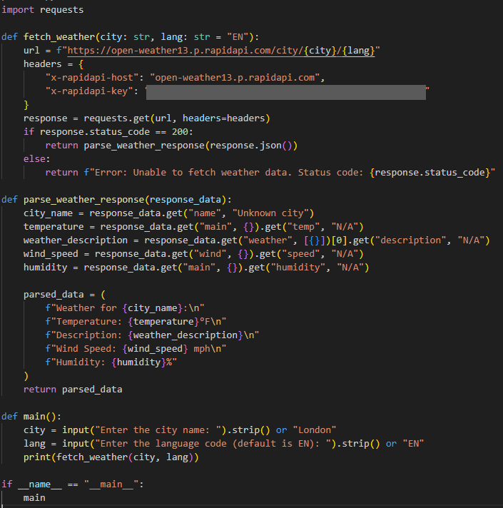
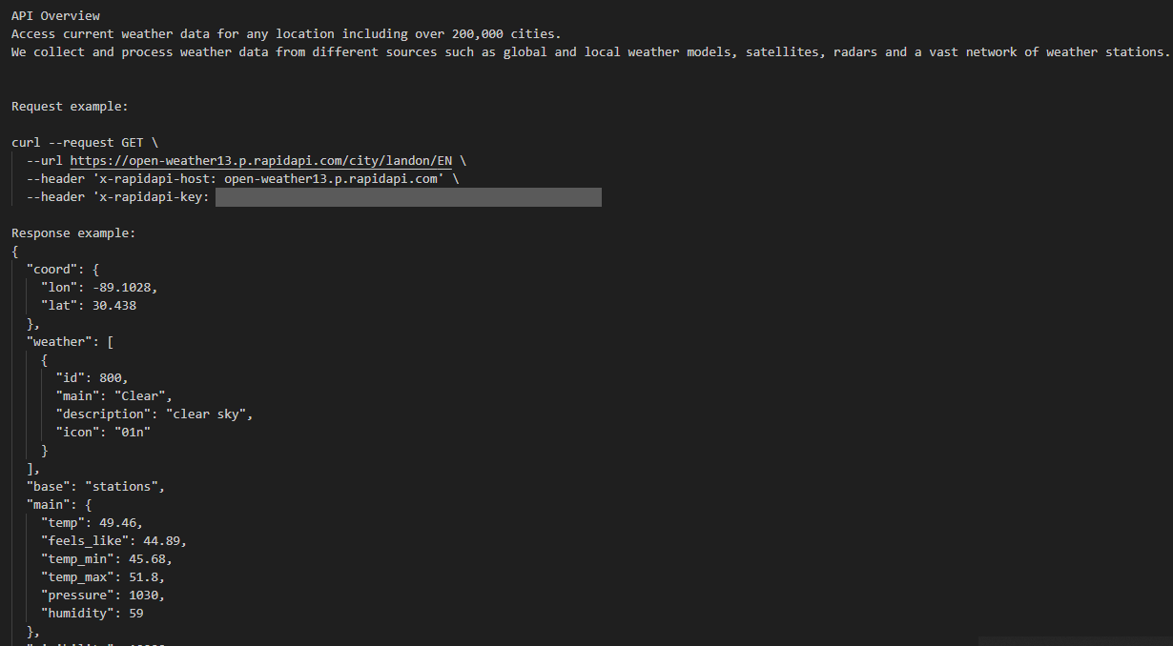
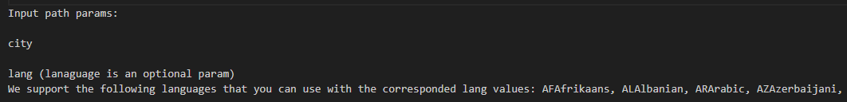

Slide 25
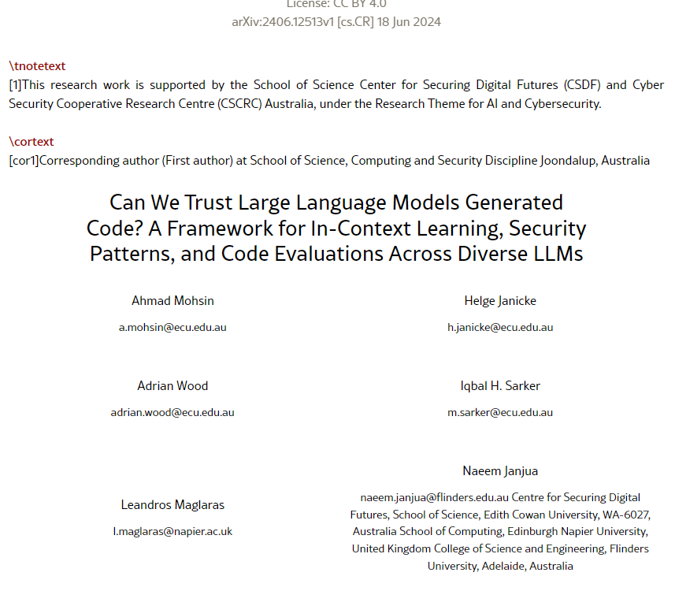
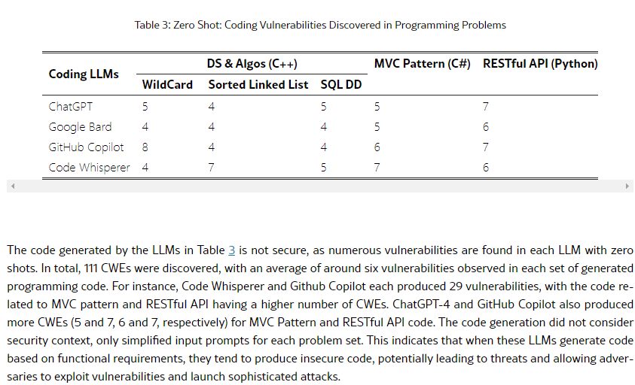
Security and Ethical Concerns
Security Challenges
  Vulnerabilities in Generated Code: Generative AI can unintentionally introduce vulnerabilities into the software. For example, AI-generated code may lack proper input validation or employ insecure coding practices, making the software susceptible to attacks such as SQL injection.
  Data Leakage Risks: Large Language Models (LLMs) are often trained on extensive datasets, and there is a risk of unintended data leakage. Sensitive or proprietary information may be embedded within the generated outputs, leading to potential security and confidentiality breaches.
Ethical Concerns
  Accountability and Responsibility: One of the key ethical challenges is determining who is accountable for AI-generated code. When an AI model produces faulty or harmful code, it is unclear whether the developer, the organization, or the AI itself bears responsibility. This lack of accountability complicates the ethical use of AI in production environments.
  Transparency and Explainability: Generative AI models often operate as "black boxes," where it is difficult to understand how specific outputs are derived. This lack of transparency can lead to ethical concerns, especially when AI-generated code is used in critical systems where explainability is essential.
Notes:
Common Weakness Enumeration (CWE) is a category system for hardware and software weaknesses and vulnerabilities. It is sustained by a community project with the goals of understanding flaws in software and hardware and creating automated tools that can be used to identify, fix, and prevent those flaws.

Slide 26
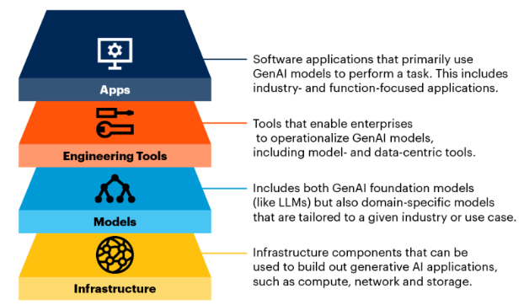
Scalability and Integration
Scalability Challenges:
Scalability is a key consideration when implementing generative AI models in software production. Generative AI solutions must be able to handle increasing workloads, both in terms of model performance and data processing, without compromising efficiency or reliability.
Integration with Existing System
Integrating generative AI into existing software production environments requires careful consideration of compatibility, adaptability, and system cohesion.
https://www.linkedin.com/pulse/tech-stack-gen-ai-rahul-kumar-3riac/

Slide 27
Resource Consumption
High GPU/TPU Requirements: Training and deploying generative AI models require powerful hardware, such as GPUs (Graphics Processing Units) or TPUs (Tensor Processing Units). These specialized processors are necessary to handle the parallel computations required by deep learning, which significantly increases hardware costs.
Memory and Storage Needs: Generative AI models often have billions of parameters, which require large amounts of memory and storage to operate. This can present challenges for organizations that lack the necessary infrastructure to store or manage these large models effectively. Moreover, the storage needs also extend to datasets, which can be vast and require careful management to ensure efficiency.
Cloud Infrastructure Costs: The use of cloud infrastructure to manage and run generative AI models can result in substantial costs, particularly if models need to be accessed frequently or deployed at scale. Cloud resources, such as those offered by AWS, Azure, or Google Cloud, allow for flexible scaling, but they can also lead to unpredictably high expenses, especially when dealing with continuous training or large-scale inference.
Carbon Footprint: The carbon footprint associated with the power consumed by AI model training is a growing concern. Data centers that power AI computations require considerable electricity, and unless renewable energy sources are used, this contributes to greenhouse gas emissions. This environmental impact is a key consideration in the responsible use of generative AI.

Slide 28
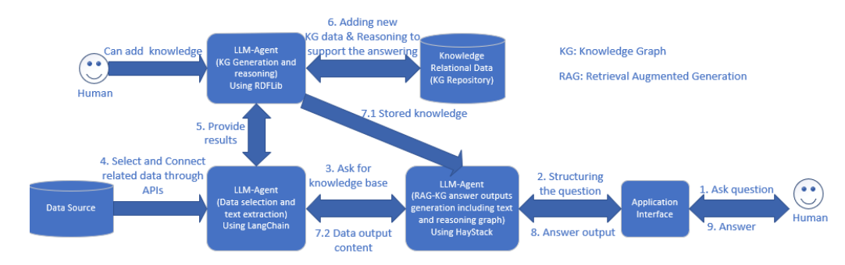
Future Research Opportunities
Enhancing Reliability and Trust: Development of advanced RAG-KG-IL and Human-in-the-Loop algorithms to improve the robustness, transparency, and trustworthiness of AI systems.

Slide 29
Future Research Opportunities
Research on Cloud Agent Communication Protocols: Design of innovative communication protocols in cloud environments to enhance seamless AI integration with existing SaaS frameworks, enabling interaction between components or microservices via LLM-based agents.
_{Software Product Service}
_{Software Product Service}
_{Agent 1}
_{Agent 2}
_{Software Product Service}
_{Agent 3}

Slide 30
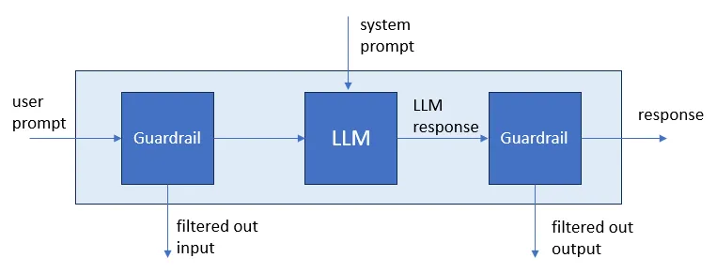
Future Research Opportunities
AI Security and Ethics in Software Production: Creation of scalable and adaptable guardrail systems to ensure secure, ethical, and responsible AI deployment in software development.

Slide 31
Future Research Opportunities
Green AI Solutions: Exploration of fine-tuning or training smaller, more efficient, and reliable LLMs tailored for specific domains to reduce computational overhead and promote sustainability.

Slide 32
References
Introducing a Gen AI-Powered Chat Integration with Jira and Confluence Knowledge Base, https://www.softserveinc.com/en-us/blog/introducing-a-gen-ai-powered-chat-integration
The AI Code Editor – Cursor, https://www.cursor.com/
GitHub Spark, https://githubnext.com/projects/github-spark
Amazon Bedrock: The easiest way to build and scale generative AI applications with foundation models, https://aws.amazon.com/bedrock/
Airflow Architecture: A Deep Dive into Data Pipeline Orchestration, https://medium.com/@bageshwar.kumar/airflow-architecture-a-deep-dive-into-data-pipeline-orchestration-217dd2dbc1c3
Yi Dong, Ronghui Mu, Gaojie Jin, Yi Qi, Jinwei Hu, Xingyu Zhao, Jie Meng, Wenjie Ruan, and Xiaowei Huang. (2024). Building Guardrails for Large Language Models. arXiv preprint. Retrieved from https://arxiv.org/abs/2402.01822.
Ahmad Mohsin, Helge Janicke, Adrian Wood, Iqbal H. Sarker, Leandros Maglaras, and Naeem Janjua. (2024). Can We Trust Large Language Models Generated Code? A Framework for In-Context Learning, Security Patterns, and Code Evaluations Across Diverse LLMs. arXiv preprint. Retrieved from https://arxiv.org/abs/2406.12513.

Slide 33
Demo
LucenAI application

